Slide 1
Smart Indoor Safety & Comfort Monitor

Slide 2
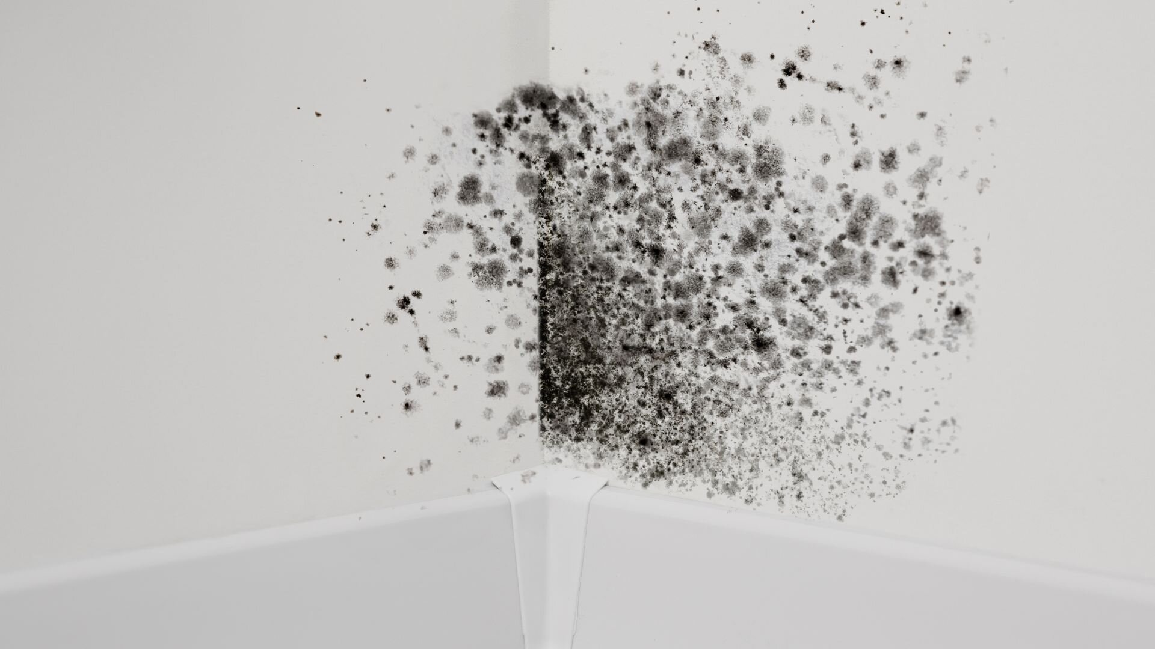

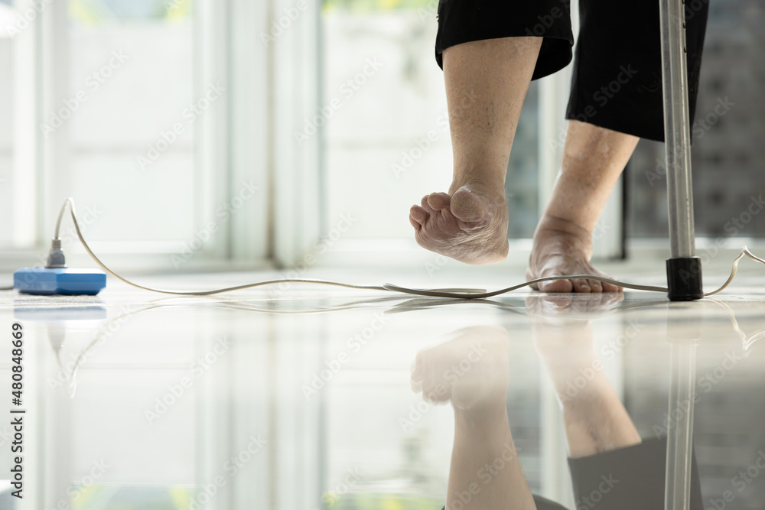
Problem statement
Indoor environments affect health, comfort, and safety
Risks:
High humidity leads to mould growth and illness
The obstructed pathways can causes accidents like tripping over an object.
The goal of this task would be to develop a multi sensor IoT systems that monitors both domains

Slide 3
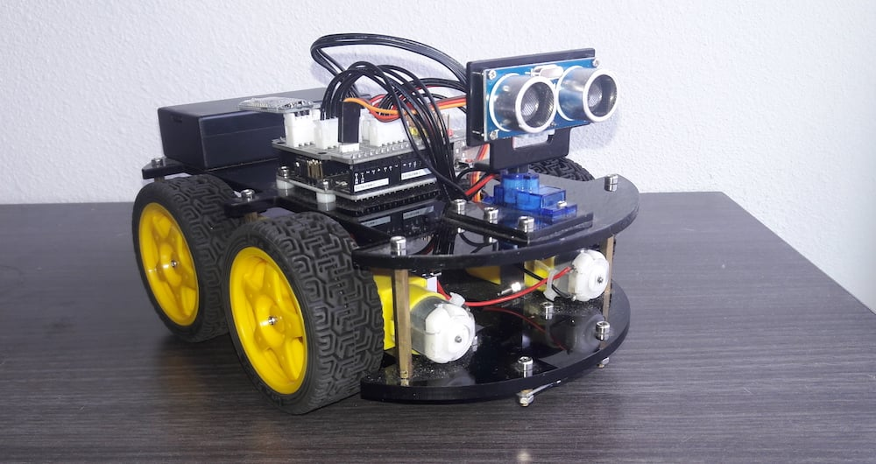
Existing method
WHO in 2009 have said that the humidity level of 70-80% would cause an increase in mould risks
The temperature comfort the sensors placement errors, and accuracy matters.
Ultrasonic sensor is widely used in robotics for obstacle detections and also uses it so the robot knows how to avoid the obstacle.
The current IoT projects only got comfort monitoring only like temp, humidity and CO2, The Robotics projects the safety monitoring only for detecting the distance and obstacle. Lastly, both of these methods are integrate at a low cost.

Slide 4
Proposed Methodology
Component:
DHT22 Temperature and Humidity
HC-SR04 Distance/ Obstacle detection
Controller: Arduino Nano 33 IoT
Data Logging:
Arduino Sketch
Python Script to CSV
Graphs with Pandas + matplotlib

Slide 5
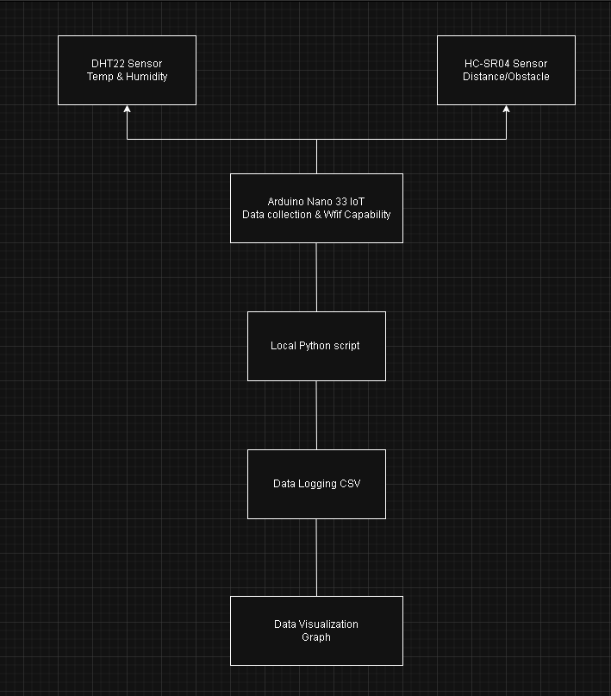
System Architecture

Slide 6
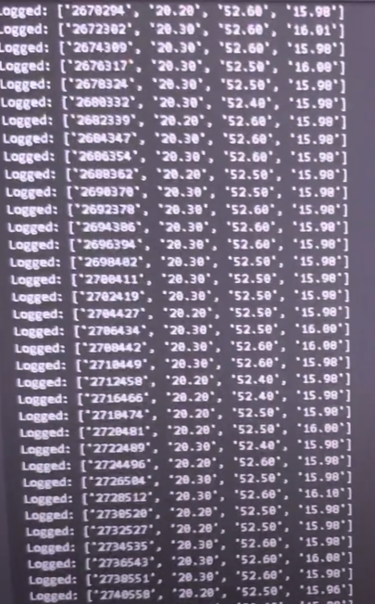
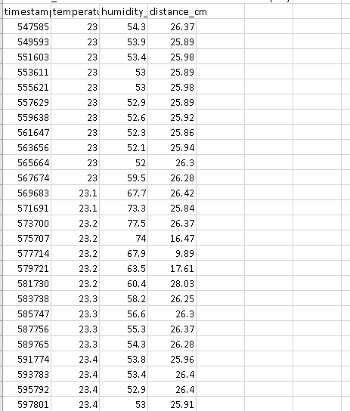
Data Capture & Storage
Programmed the Arduino to collect data from the sensors
Output those data that was collected into python serial logger
Then the python code will create a csv files to store the data locally
Data Type: Temperature (Celcius), Humidity (%) and Ultrasonic distance (cm)

Slide 7


